Slide 1
Longitudinal data
And centering

Slide 2
Centering in MLM
Centering our independent variables gives us a meaningful intercept
In normal linear regression, centering is mainly important when we have interactions in the model.
Because with interactions, each simple effect is calculated at the zero value of the other variable

Slide 3
Centering in MLM
Centering in MLM is a lot more important than in ordinary regression, as it can change the meaning of our analysis substantially
We have two options for centering that do quite different things to our level 1 IVs:
Grand-mean centering - center relative to the grand mean (normal centering)
Group-mean centering - center relative to the level 2 group

Slide 4
Why does centering matter?
I mentioned MLM is like fitting a separate regression within each group, with its own intercept
This is true, but:
When we do this with a dummy-coded group factor in normal regression, between-group differences in the DV are removed from the model
In MLM, these differences are still present as (random) errors to be minimized, and so are part of the model.

Slide 5
What does that mean?
MLM tries to create the optimal balance of using within-group and between-group information to create a pooled regression estimate
This maximises information when relationships between the IV and the DV at level 2 are simply the results of level 1 effects acting at the group level.
Example: Within and between-county differences in soil uranium content predicting measured radon

Slide 6
Why does centering matter?
However, if separate effects are occurring at the within-group and between-group (or level 1 and level 2) levels:
The single IV parameter in MLM will try to pool between them
Can result in regression estimates that are uninterpretable mix of within and between-group variation

Slide 7
Example
Measuring workload and wellbeing in organisational groups (Enders & Tofighi, 2007)
Workload varies within, but also between groups
There are relationships at both the group and individual level

Slide 8
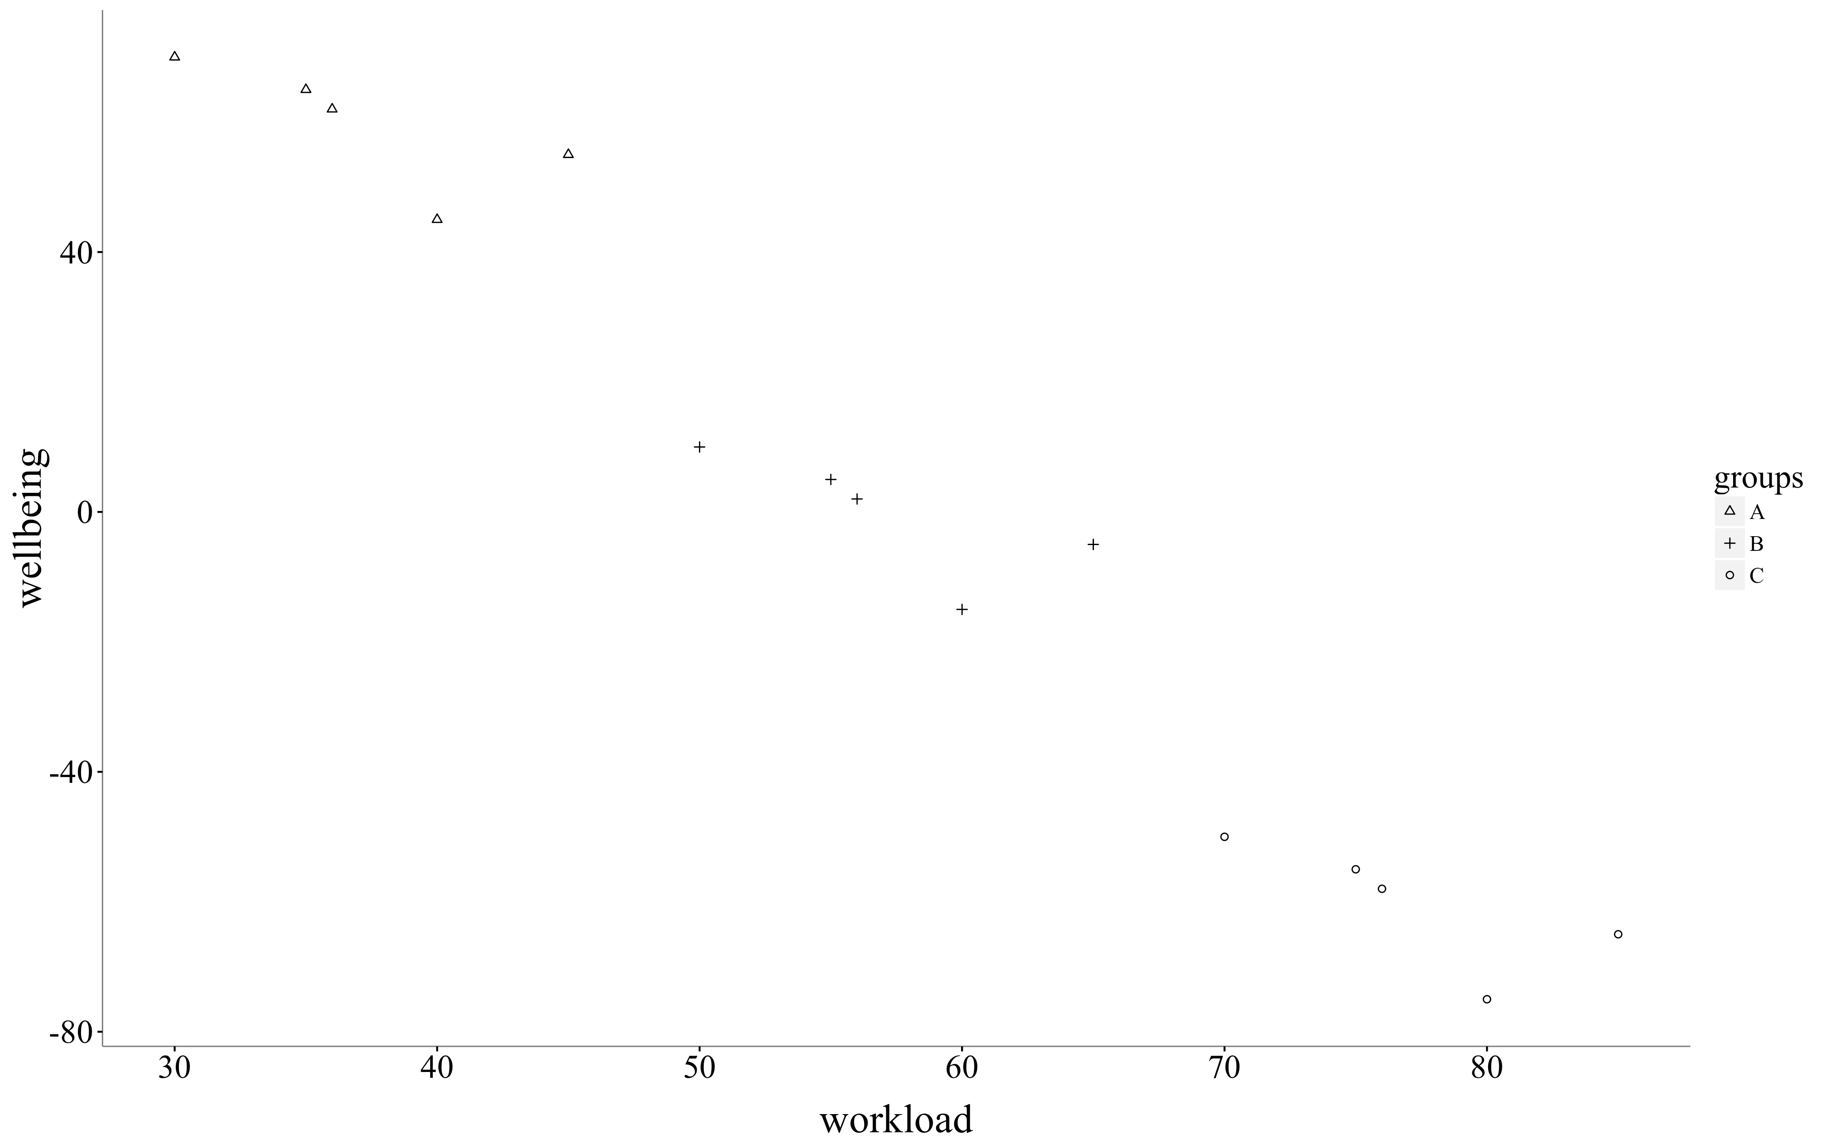
Example

Slide 9
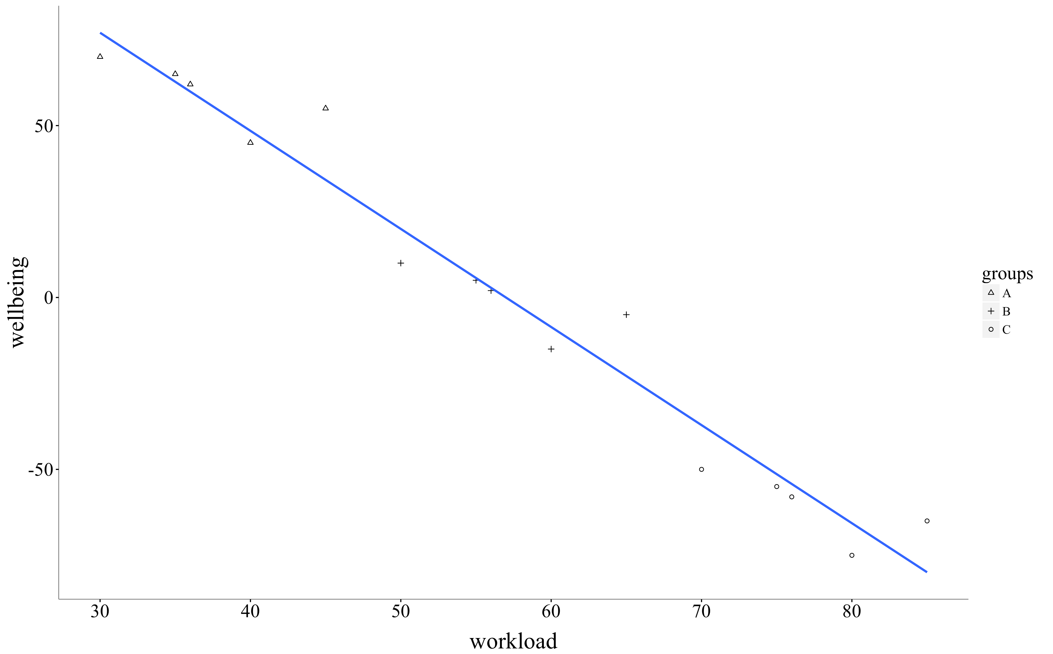
Ordinary regression

Slide 10
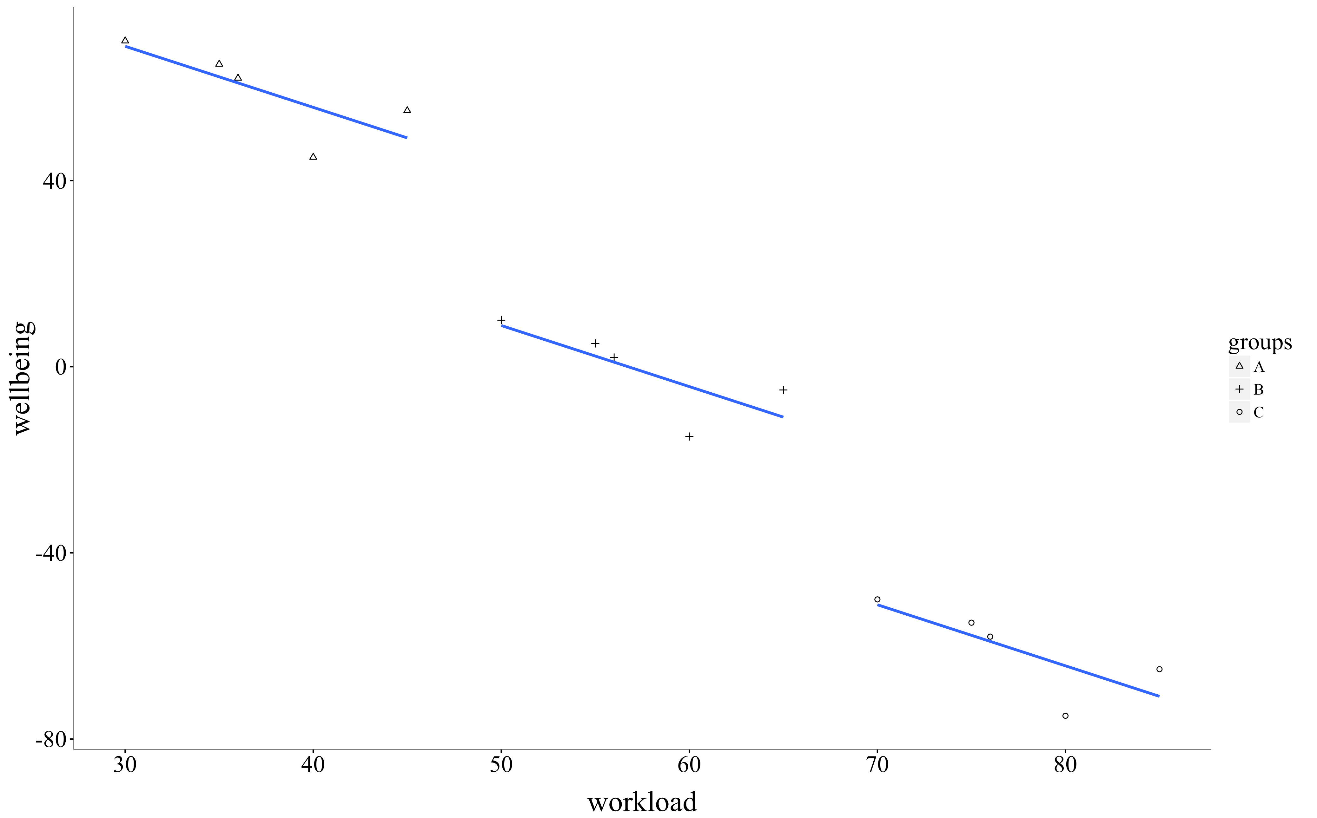
Purely within-group

Slide 11
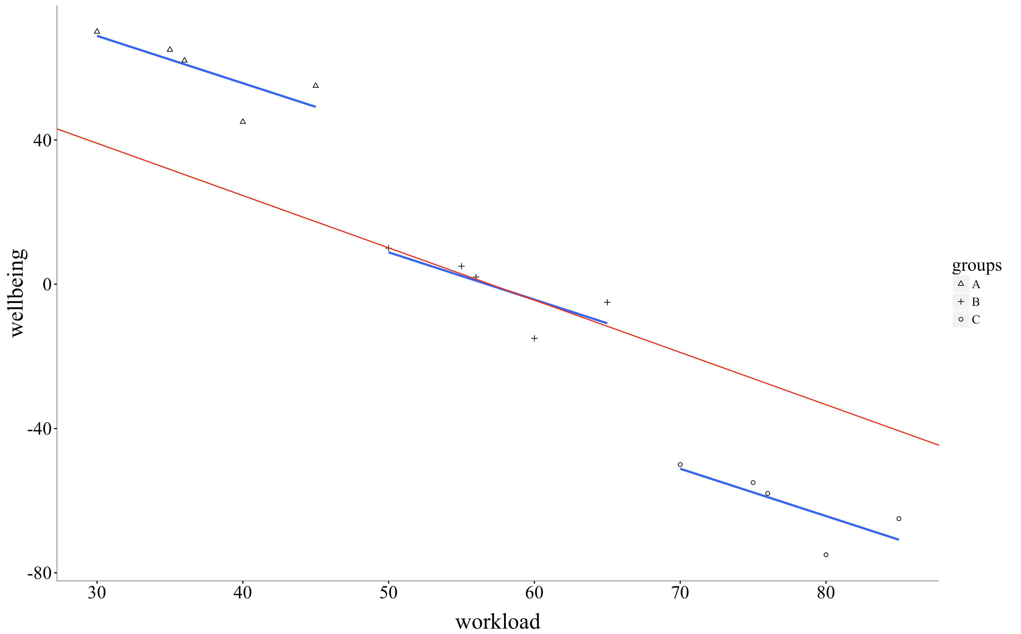
MLM with GMC

Slide 12
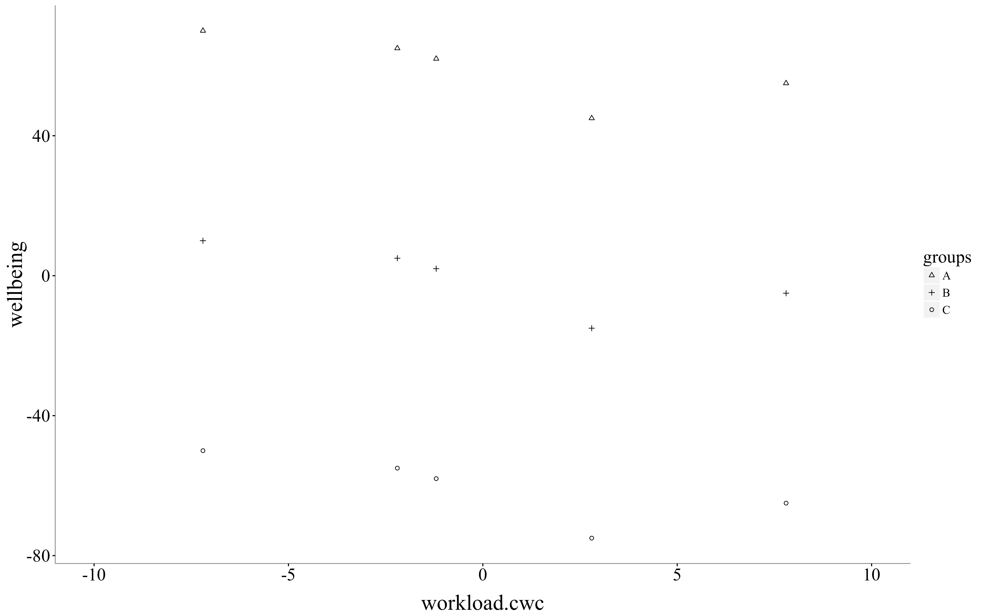
Within-group centering

Slide 13
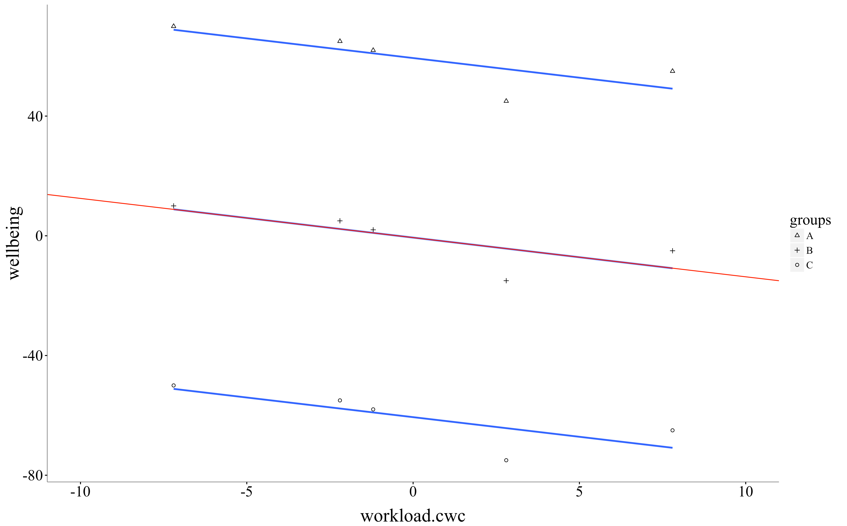
MLM and within-group

Slide 14
When does it matter?
The choice of grand mean or within-group centering only matters:
For level 1 independent variables that vary across level 2 units
Thus, doesn’t matter in repeated measures designs

Slide 15
When does it matter?
The choice of grand mean or within-group centering often matters:
For studies with people nested within groups, if at least one IV is an individual difference
The choice of grand mean or within-group centering really matters:
For studies with multiple observations of each person (e.g. ESM, daily diary, longitudinal), if at least one IV is an individual difference

Slide 16
Group-mean centering
Separate out questions like:
Do students with higher SES achieve more, or do schools with higher average SES have higher achieving students
Are people more anxious on days when they are more depressed, or are depressed people more anxious?

Slide 17
Group-mean centering
Especially important for cross-level or level 1 interactions
With grand mean centering, level 1 slopes are blends of level 1 and level 2.
Which means interactions with them will be even more difficult to interpret.

Slide 18
Rules of thumb
Group-mean centre your level 1 (continuous) predictors unless they only vary within level
Grand-mean centre level 2 predictors (so that interactions with them are interpretable)

Slide 19
Alternatives
Can add the level 2 mean on your level 1 predictor to your model. If you do this with your level 1 predictor grand mean centered:
At level 1, this is the same as group-mean centering
At level 2, you’ll estimate the group-level effect, controlling for level 1 effects

Slide 20
Alternatives
Can add the level 2 mean on your level 1 predictor to your model. If you do this with your level 1 predictor group mean centered:
At level 1, this is the same as group-mean centering (well, it is group-mean centering)
At level 2, you’ll estimate the group-level effect, ignoring level 1 effects
This assumes that within and between group effects are completely separable - i.e., no group-level differences could be caused by aggregate level 1 effects

Slide 21
Alternatives
Which method you use depends on theory
If you think your level 1 effect is about position relative to the group only then you might choose the second option.
e.g. Being the highest in your group on workload causes stress, but absolute workload doesn’t matter

Slide 22
Recommendations
If you only include the level 1 predictor in the model, and it varies across level 2 units, group-mean center it
If you include the level 2 mean of your predictor in the model, then use the grand-mean centered level 1 predictor
Unless you want to investigate a level 2 process you think is entirely separable from your within-group process

Slide 23
Longitudinal data analysis
Special case of MLM
Time points within individuals
Growth models, intervention studies, experience sampling, daily diary surveys, etc

Slide 24
Unconditional growth model
Simplest form of analysis - has time as a fixed effect and controls for person level clustering
No need to centre time by group (person) since it’s within-individuals
Time is centered so that the first time point is 0 - this gives meaningful intercepts, especially for interactions

Slide 25
Conditional growth model
More complex form of analysis - specifies a cross-level interaction, where we test whether some person-level difference or manipulation affects the rate of change
If the IV is at the person level, grand mean center it

Slide 26
Within-person models
Can also look at models of change within-person, where both IV and DV change at each time point.
Cross-sectional:
Do changes in the IV co-occur with increases in the DV?
Want to group-mean center (within person) so you’re asking about the effects of change within people, removing individual differences

Slide 27
Within-person models
Can also look at models of change within-person, where both IV and DV change at each time point.
Lagged:
Do changes in the IV at T(n) predict changes in the DV at T(n+1)?
Need to create lagged versions of IVs to predict the current time’s DV score.

Slide 28
How this looks in R
Unconditional growth model
lmer(height ~ time + (1|person))
Conditional growth model
lmer(height ~ time*gender + (1|person))
Technically a cross-level interaction with a level 2 (person-level) predictor

Slide 29
How this looks in R: Models of change
Cross-sectional (within person IV, group-mean centered)
lmer(happiness ~ sugar.c + (1|person))
Lagged (within person IV, group-mean centered, lagged)
lmer(happiness ~ sugar.c_lag + (1|person))
lmer(happiness ~ sugar.c_lag + sugar.c + (1|person))

Slide 30
More advanced models
lmer(happiness ~ sugar + sugar.mean + (1|person) + (1|day))
Here we simultaneously predict happiness from blood sugar (grand mean centered) and the person’s mean blood sugar
Allows us to look at within and between person effects simultaneously

Slide 31
More advanced models
lmer(outcome ~ manip*individual.diff*time + (1|person))
Here we have a conditional growth model, but it’s conditional on an interaction.
We’re examining whether a manipulation affects change over time, but also whether that effect might depend on some individual difference

Slide 32
Other models
Latent growth models and cross-lagged panel models
Both of these are usually implemented using structural equation modelling

